Slide 1
Unsupervised Learning

Slide 2


Explain the mechanism of unsupervised learning
Describe different clustering techniques

Slide 3
Unsupervised Learning: Overview

Slide 4
Unsupervised Learning: Overview
Unsupervised learning allows the model to work on its own to discover the pattern and information that was previously undetected.
It helps to find out all kind of unknown pattern in data.
It helps to find out the features required for categorization.

Slide 5
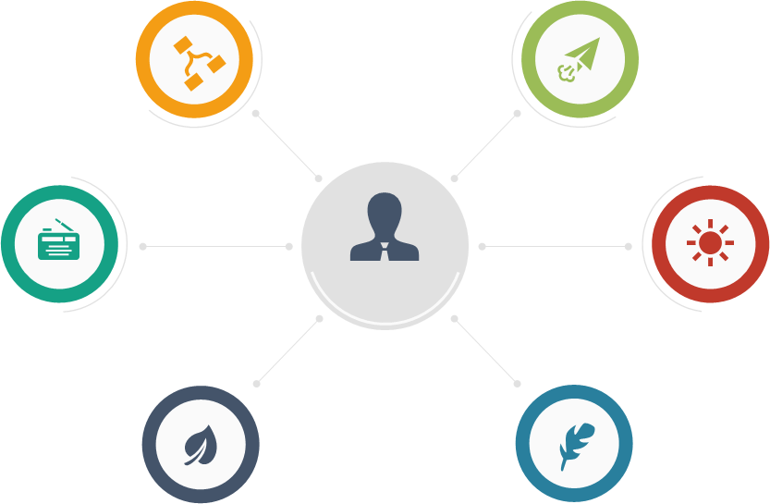
Unsupervised Learning: Real-Life Scenarios
Customer segmentation
Recommended systems
Feature elicitation
Targeted marketing
Meaningful compression
Big data visualization

Slide 6
Unsupervised Learning: Process Flow
There are no labels on the data. The machine learning algorithm searches for the patterns it can detect.
Unsupervised Learning Model
Training text,
documents,
images, etc.
Feature
vectors
Machine
learning
algorithm
Feature
vectors
Likelihood
or cluster id
or better
representation
New text,
document,
images, etc.
Predictive
model
Notes:
Trainer Notes: Explain the following:
Absence of labels in data
Above flowchart

Slide 7
Unsupervised Learning vs. Supervised Learning
The only difference is the labels in the training data.
Feature
vectors
Feature
vectors
Training text,
documents,
images, etc.
Training text,
documents,
images, etc.
Machine
learning
algorithm
Machine
learning
algorithm
Labels
Feature
vectors
Likelihood
or cluster id
or better
representation
New text,
document,
images, etc.
Feature
vectors
Predictive
model
New text,
document,
images, etc.
Predictive
model
Expected
label
Notes:
Trainer Notes: Explain the following:
Comparison between supervised learning and unsupervised learning with respect to labelled data
The output of supervised learning and unsupervised learning model

Slide 8





Unsupervised Learning: Example
Similar-looking birds/animals are grouped together depending on their characteristics.
Unsupervised
learning
Notes:
Trainer Notes: Explain the following:
The above example with respect to unsupervised learning
Also, why it isn’t supervised learning

Slide 9
Algorithms in Unsupervised Learning

Slide 10
Algorithms Used in Unsupervised Learning
Unsupervised learning
Clustering
Association rule
It is a method of grouping the objects into cluster.
The grouping is done in such a way that objects with most similarities remain into a group and objects with no or less similarities placed in another groups
It is used to find out the relationships between the variables in the large databases.
For example, people that buy a new home most likely to buy new furniture.

Slide 11
Types of Clustering
Clustering
Hierarchical
clustering
Partitional
clustering
Agglomerative
Divisive
K-means
Fuzzy C-means
Notes:
Trainer Notes: Explain the following:
Types of clustering
Difference between Hierarchical and Partitional Clustering

Slide 12
Application of Unsupervised Learning
Unsupervised learning can be used for anomaly detection as well as clustering
Anomaly detection
0.9
7
0.8
6
0.7
x
x
x
5
+
x
x
x
x
x
+
x
+
+
x
+
+
+
x
x
x
x
+
+
x
0.6
+
x
+
+
+
x
+
4
+
x
+
0.0033
3
0.5
0.0251
0.008
2
0.0119
0.4
1
0.3
0
-1
0.2
-2
0.1
0
2
4
6
8
10
0
0.1
0.2
0.3
0.4
0.5
0.6
0.7
0.8
0.9
0.1
Identifying similarities in groups
(Clustering)

Slide 13
Unsupervised learning looks for previously undetected patterns.
Clustering and association are the two algorithms preferred for unsupervised learning implementation.
In clustering, objects with similarities are placed in one group and objects with no or less similarities are placed in another group.
Association rule is used to find out the relationships between the variables in the large databases.

